Slide 1
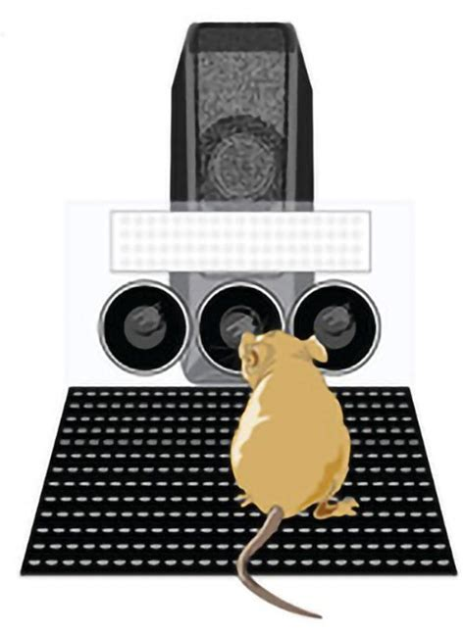
Intro to AI
01
Simulating real-life rodent reward-based learning in a dynamic two-armed bandit task.
Presented by Ellen Martin

Slide 2
Intro to AI
02
Overview
  Understanding the cognitive processes underlying decision-making is a key challenge in the fields of neuroscience and artificial intelligence.
  These fields both aim to uncover how organic, biological systems learn to make optimal decisions.
  We can address this question by applying algorithmic approaches, such as fitting Reinforcement Learning (RL) models.

Slide 3
Intro to AI
03
Project Objectives
Simulate / mimic rodent decision-making and learning curves in a two-armed bandit task
Test different reinforcement learning models to best fit rodent behaviour
Estimate best-fitting parameters to make inferences regarding rodent behaviour

Slide 4
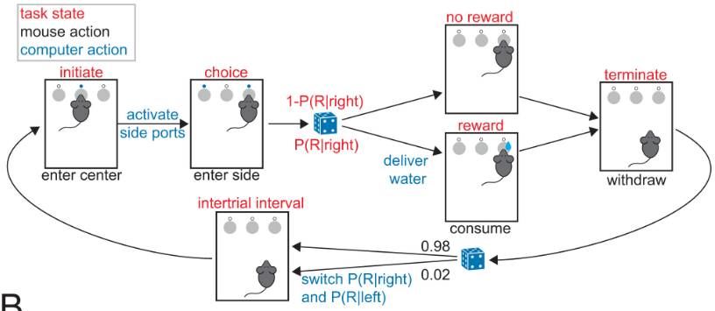
Intro to AI
04
Six mice choose from the right or left arm to receive a reward (water) over repeated trials
Study Mechanics Beron et al (2022)
Different trial conditions:
90-10: : ’good’ arm delivers reward (water) 90% of the time, ‘bad’ arm delivers reward 10% of the time (mean = 649 trials, SD = 138)
80-20: ’good’ arm 80% of the time rewarded, ‘bad’ arm 20% of the time rewarded (mean = 514 trials, SD = 104)
70-30: ‘good’ arm 70% of the time rewarded, ‘bad’ arm 30% of the time rewarded (mean = 784, SD = 110)
Periodic switching of ‘good’ arm
Mice have to re-learn which arm is ‘good’ (i.e., more rewarding) after an unpredictable switch

Slide 5

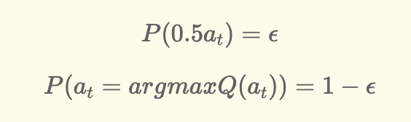

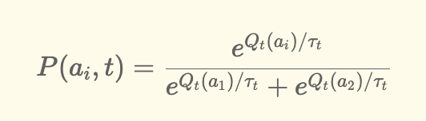
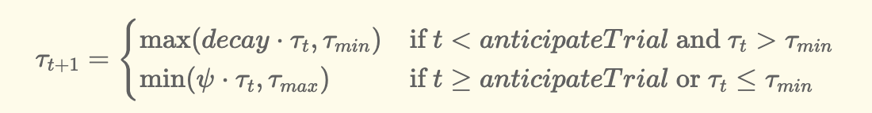
Intro to AI
05
Reinforcement Learning Models
1) Epsilon Greedy Q-Learning Model
2) Q-Learning with ‘Forgetting’/’Satiation’
3) Q-Learning with ‘Anticipation’ of switch, and Boltzmann-Exploration
  To account for mice gradually selecting the better arm less with increasing trials, a global ‘forgetting’ parameter is implemented (decay).
  This can also be interpreted as ‘satiation’, and mice no longer being thirsty.
  Specify a Q-learning agent (simulated mouse) with no initial beliefs about the world using epsilon-greedy exploration
  If randomly generated value < epsilon, random action from action space.
  Gradually update beliefs through evidence accumulation (experience of reward or no reward)
  Simulate decisions based on Q-values.
  Average performance over multiple simulations.
  Rewards exploration of less explored arm by scaling up the Q-value
  Models potential anticipation of a ‘switch’ in rewarding arms that mice may come to expect with repeated trials by increasing stochasticity in latter trials

Slide 6
Intro to AI
06
Results and Demonstration
https://github.com/ellenmartin11/simulating_mouse_learning_RL

